Slide 1
DARIAH-DE & DARIAH-EU
Dr. Heike Neuroth
Head Research & Development Department
Göttingen State and University Library
© CC BY 4.0
https://creativecommons.org/licenses/by/4.0/

Slide 2
DARIAH-DE

Slide 3
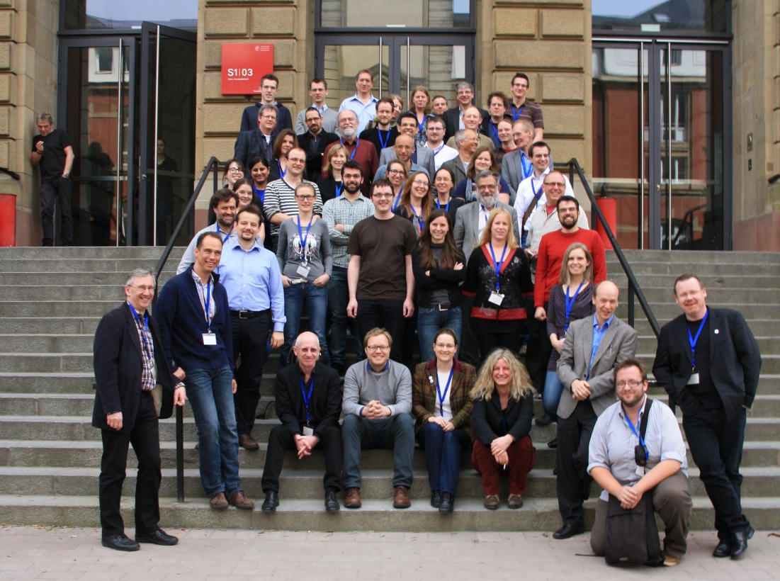
Meet DARIAH-DE (2nd funding phase)
Kick-Off Meeting in Darmstadt
March 2014

Slide 4


Key Facts
One of the 15 founding members of DARIAH-ERIC
Duration (5 years):
  Preparatory phase: 2008 – 2011
  Construction phase: 2011 – 2016
  Operational phase: 2016 – 202x?
Funding agency: Federal Ministry of Education
and Research, Germany (BMBF)
Principal Investigator: State and University Library Göttingen
20 partners: 6 universities, 5 research institutes, 4 computing centres, 2 libraries, 1 commercial partner, 1 academy, 1 NGO
Budget: about 10 Mio Euro

Slide 5


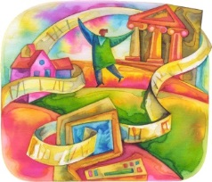

Partners
Max-Planck-Gesellschaft Garching (RZG)
GWDG Göttingen (GWDG)
Supercomputing Center Jülich (JSC)
Karlsruher Institute of Technology (KIT)
Bamberg (MInfBA)
Detmold/Paderborn (DT/PB)
Hamburg (DHd)
Köln (HKI)
Leipzig (INFAI)
Darmstadt (TUD)
Würzburg (UWÜ)
Herzog-August-Bibliothek Wolfenbüttel (HAB)
Göttingen State and University Library (SUB)
Computing Centers
Libraries
Universities
Berlin-Brandenburgische Academy of Sciences and Humanities
(BBAW)
DARIAH-DE
Partners
Academies
of Sciences
and Humanities
NGOs
Open Knowledge Foundation (OKF)
Research Institutes
Commercial Partners
Max-Planck-Institut Wissenschaftsgeschichte / Max Planck Digital Library (MPIWG/MPDL)
Deutsches Archäologisches Institut (DAI)
Steinheim-Institut für deutsch-jüdische Geschichte (STI)
Leibniz-Institut für Europäische Geschichte Mainz (IEG)
DAASI
Notes:
7 Universitäten
4 Rechenzentren
2 Bibilotheken
5 Fachspezifische Partner
1 Akademie der Wissenschaften
1 kommerzieller Partner
1 OKF
21 Partner: GCDH in DARIAH-DE II nicht mehr dabei, dafür HAB und INFAI-Leipzig, DHd-Hamburg (UAs UWÜ)

Slide 6
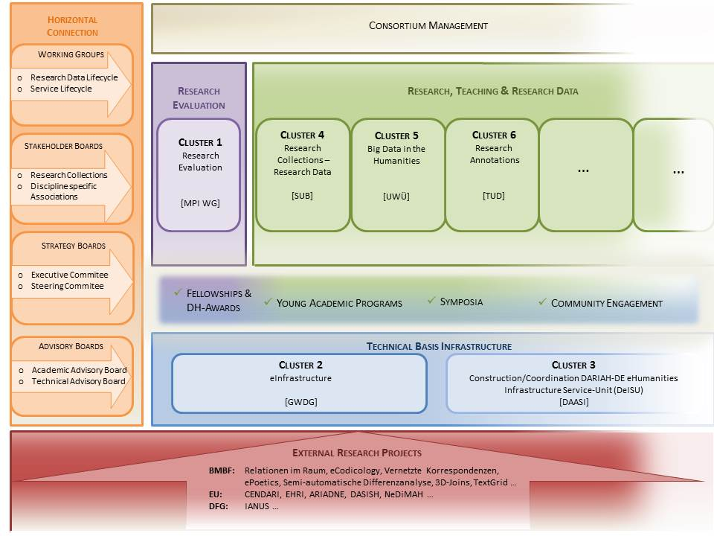

Slide 7
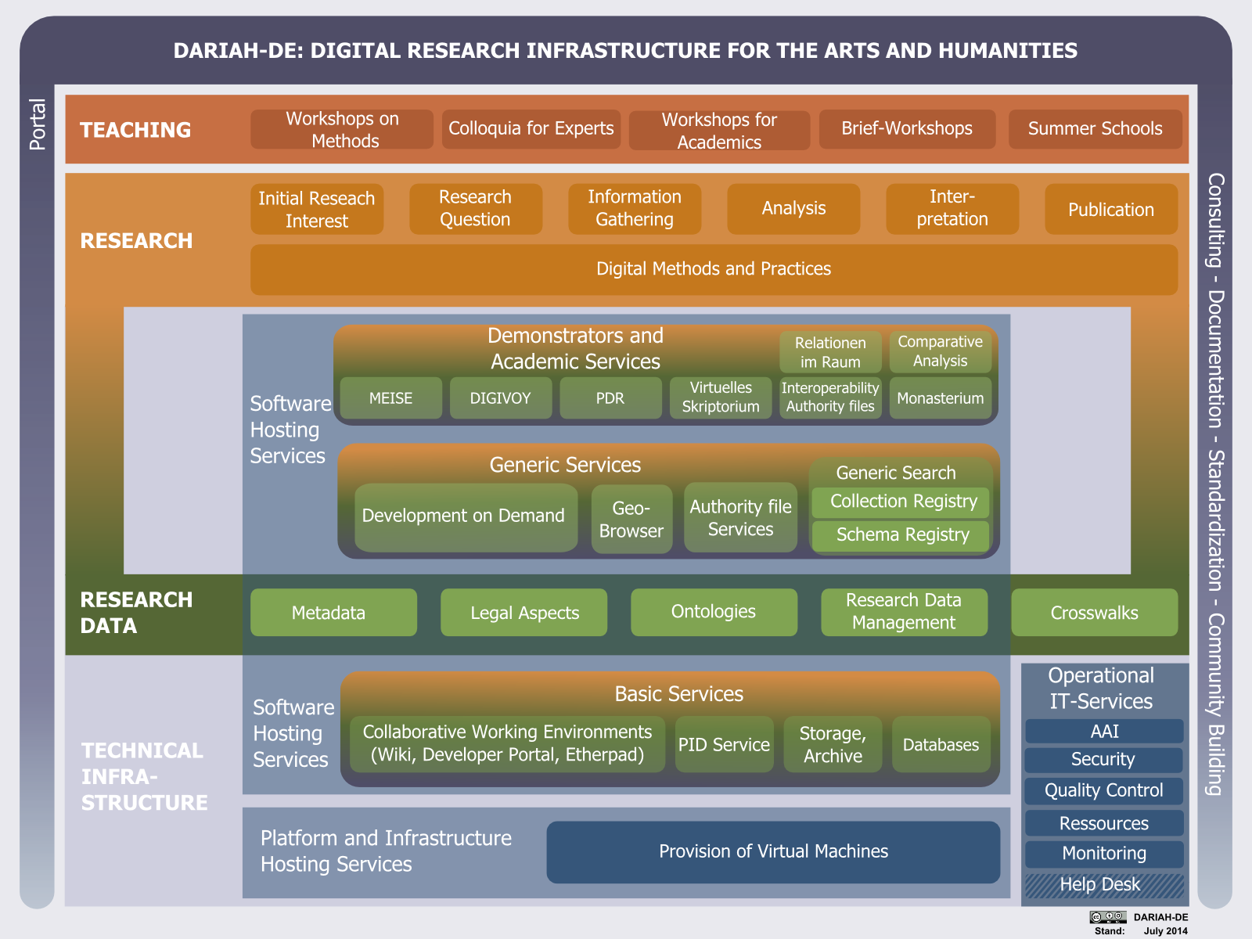

Slide 8
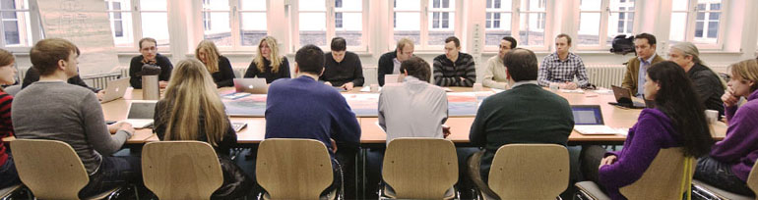
Lessons Learned
- Göttingen Impressions -
Department Research and Development at SUB Göttingen
http://www.rdd.sub.uni-goettingen.de

Slide 9
Digital Humanities (DH) at SUB
DH since 2004 (without calling it DH):
  Third-party funds: 18 projects
  (national, European and Mellon funding budget):
  Most were small and medium sized projects (2-3 partners)
Two big national projects, role as Principal Investigator (PI):
  TextGrid (2006-2015): 10 Mio Euro, 12 partners
  Virtual Research Environment
  DARIAH-DE (2011-2016plus): 10.5 Mio Euro, 20 partners
  Research Infrastructure

Slide 10
Lessons Learned: Discipline-specific
Different speed of development:
  digital archaeology … theology …
Different methods and „visions“:
  Qualitative versus quantitative
  Big data versus small/smart data
Role of applied informatics:
  Research partner? Service provider? Common research agenda/question?
  DH as new discipline?
Cross-disciplinary commonalities:
  (Technical) Research infrastructure (e.g. AAI)
  Research data curation
  Methods and tools
  Publication strategy, open access …

Slide 11
Lessons Learned: From small to big
Project teams:
  „individual research“ to „team science“
  Heterogeneity of disciplines
  Different cultures, e.g. communication, consensus building etc.
Research infrastructure
  Not really existent yet
  Balance of research-orientation & service-orientation
  Community-driven research infrastructure versus sustainability
Project co-ordination
  Additional skills needed
  Other procedures/structures needed, also in administrative units

Slide 12
Lessons learned: Sustainability
Research projects are limited in time:
  Sustainability is not (yet) an issue for projects or funders
  Brain drain, loss of qualified associates
New models needed:
  Research data curation (data centres, archives …)
  Technical infrastructure (database, tools …)
  Systematic Education of Early-career researchers
    Digital Humanities
    Data curation
    Digital turn in general ...

Slide 13
Some Highlights of
DARIAH-ERIC

Slide 14





Brief history
2006: DARIAH @ ESFRI Roadmap
2008 – 2011: Preparatory Phase project — Preparing DARIAH
2011 – 2013: Transition Phase
establishing the DARIAH-ERIC
2014 – : DARIAH-ERIC
Notes:
Centres de ressources numériques (2005)

Slide 15
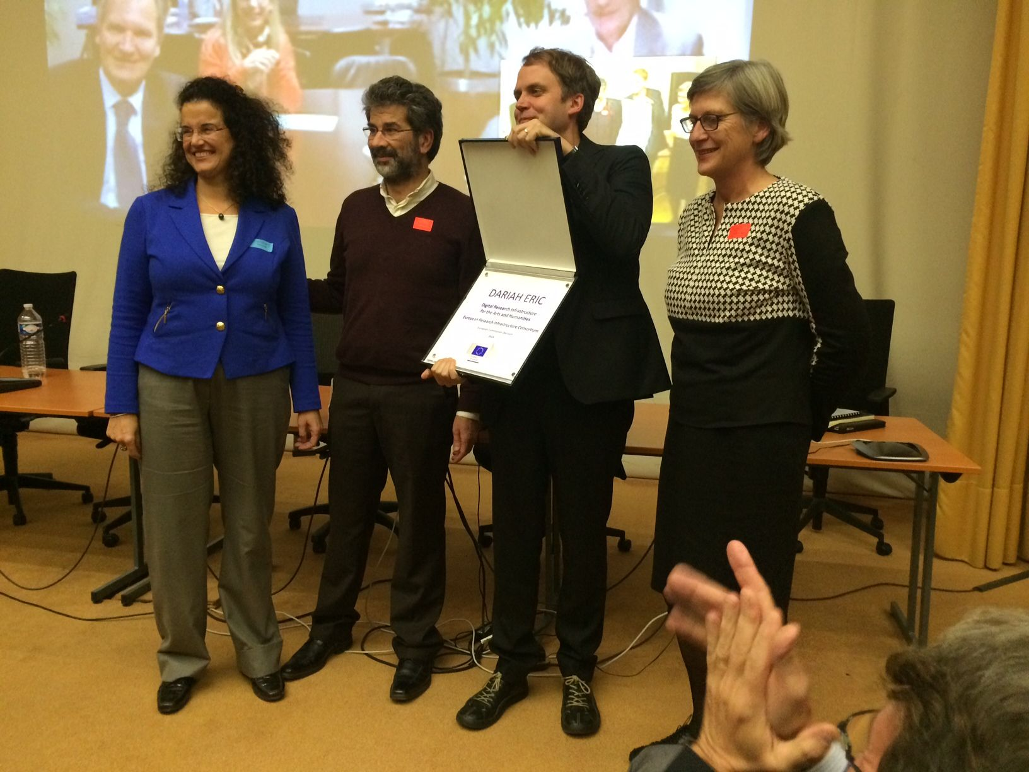
Paris, 17. Nov 2014

Slide 16




















Full Members
Founding Members
Austria
Belgium
Croatia
Cyprus
Denmark
France
Germany
Greece
Founding Members
Ireland
Italy
Luxembourg
Malta
Netherlands
Serbia
Slovenia
Candidate countries and associated members
Lithuania
Poland?
Portugal
Spain
Switzerland
Notes:
16

Slide 17
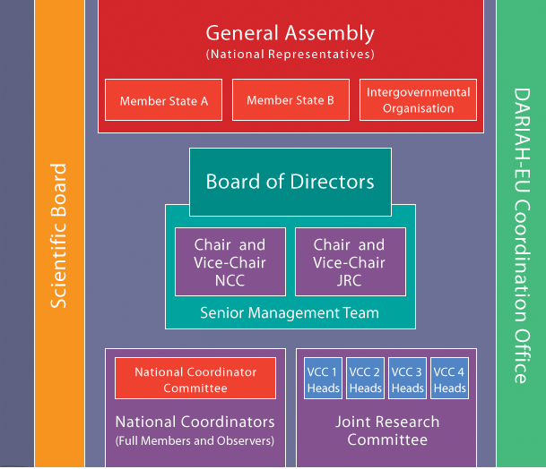
Organisational Framework
A model based upon national contributions
Expertise, technologies, capacity
as well as research communities are spread across DARIAH members
DARIAH services as a coordination
of national capacities

Slide 18



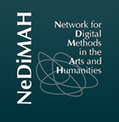

Network of affiliated EU-Projects
Archaeologists
Medieval and modern historians
Holocaust researchers
Digital methods
Digital textual scholarship
*** More are in preparation, some will be submitted in January 2015 ***

Slide 19
Open Humanities – DARIAH Call 2015

Slide 21


Thank you very much!
Questions? Comments?

